Slide 1


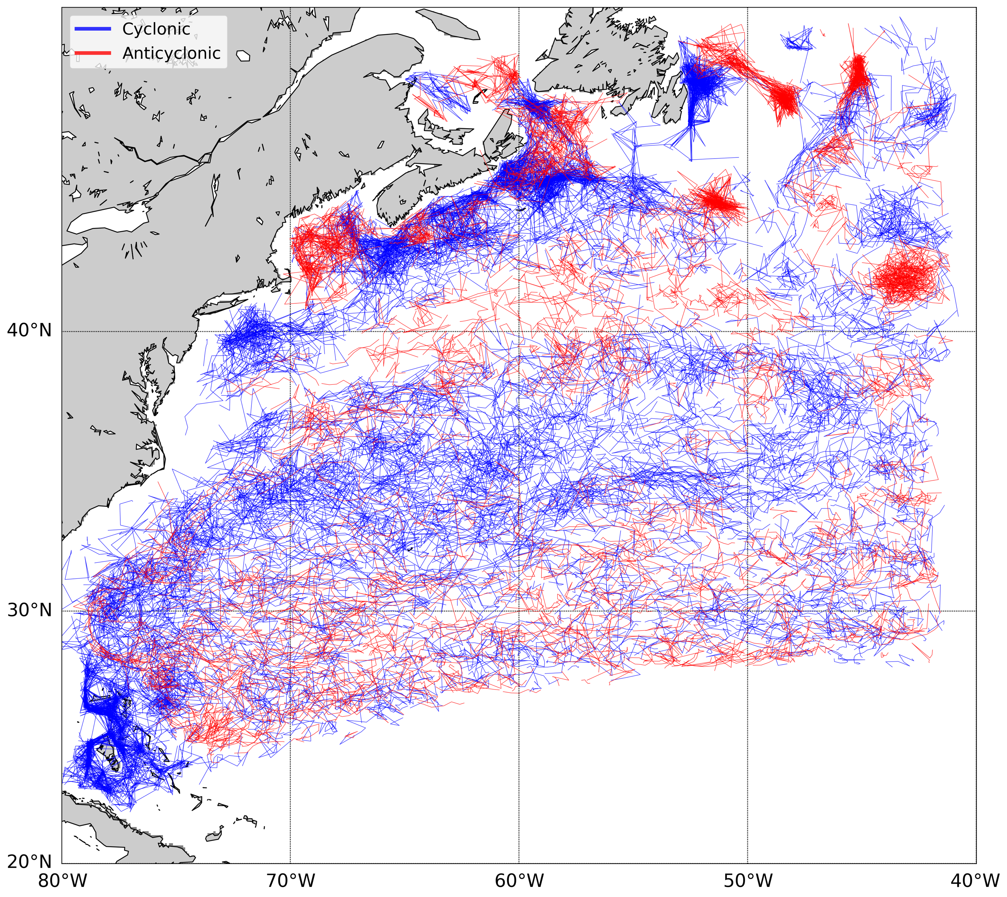
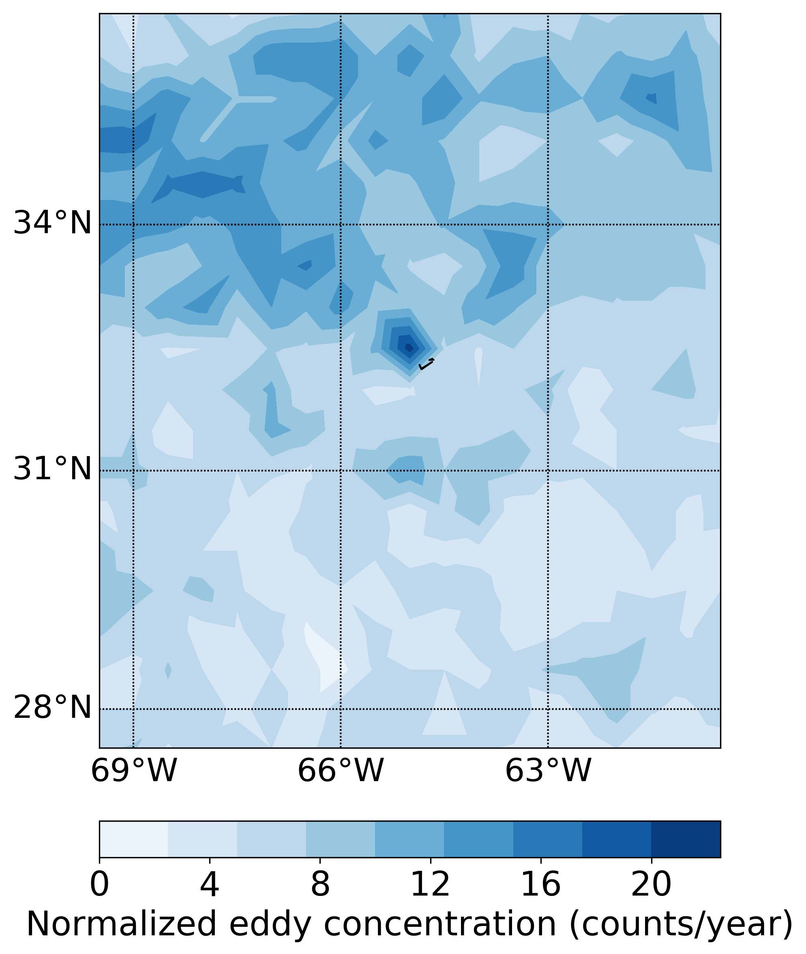
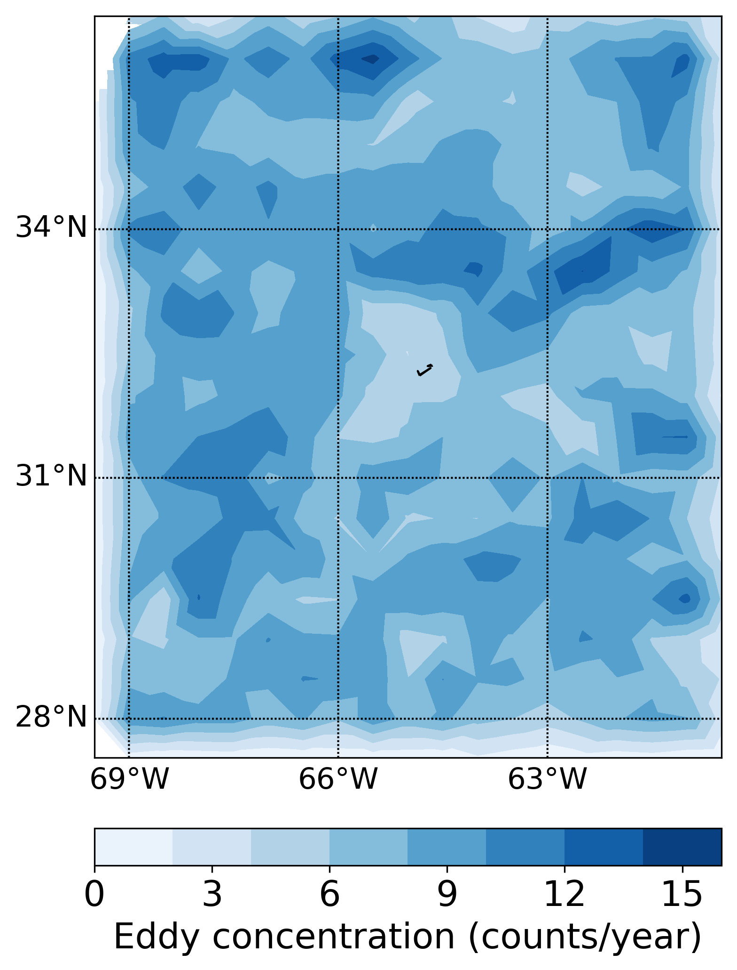
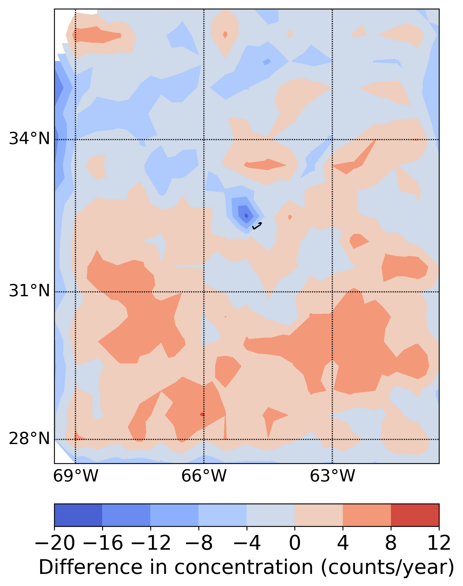
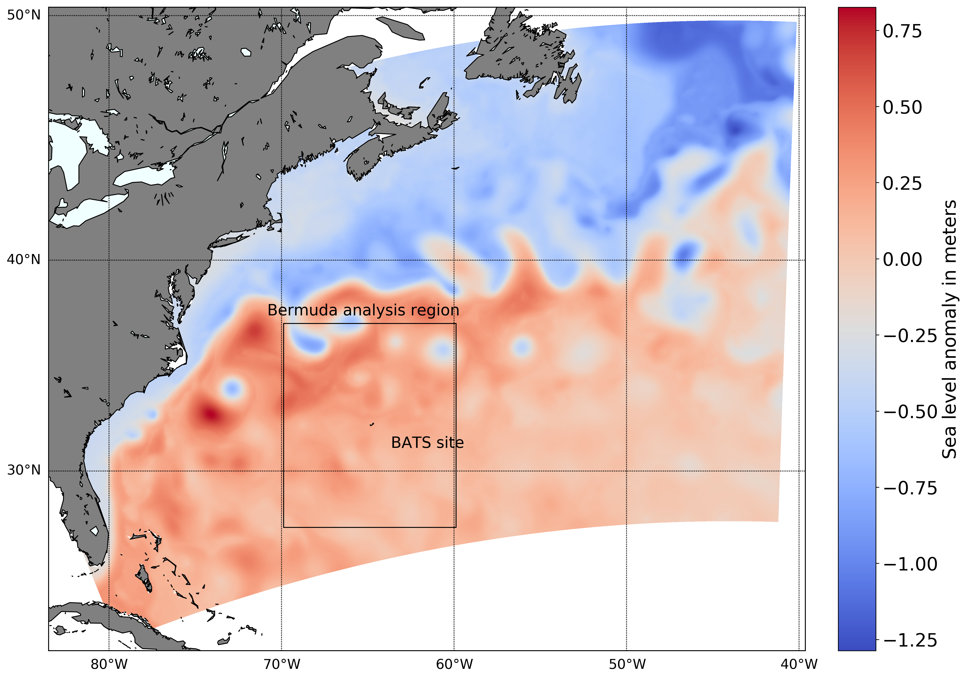
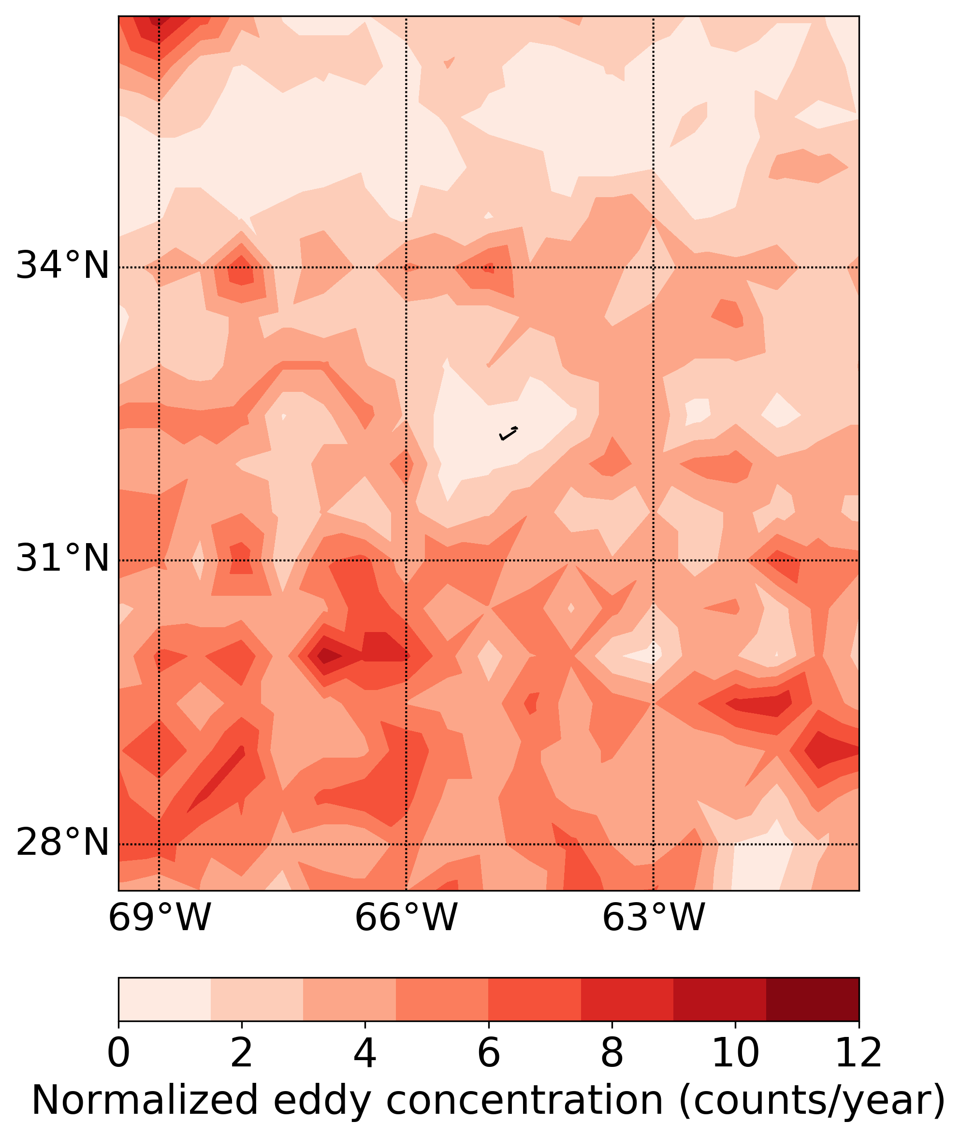
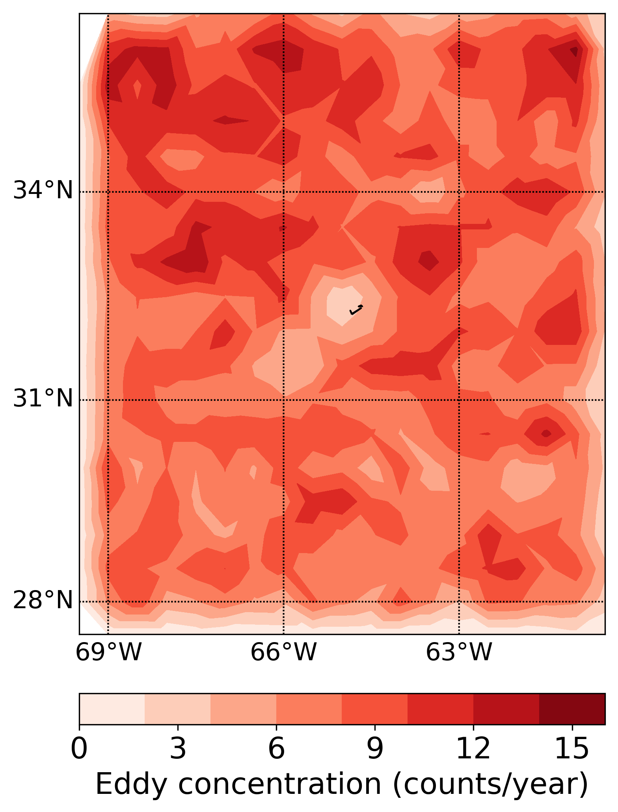
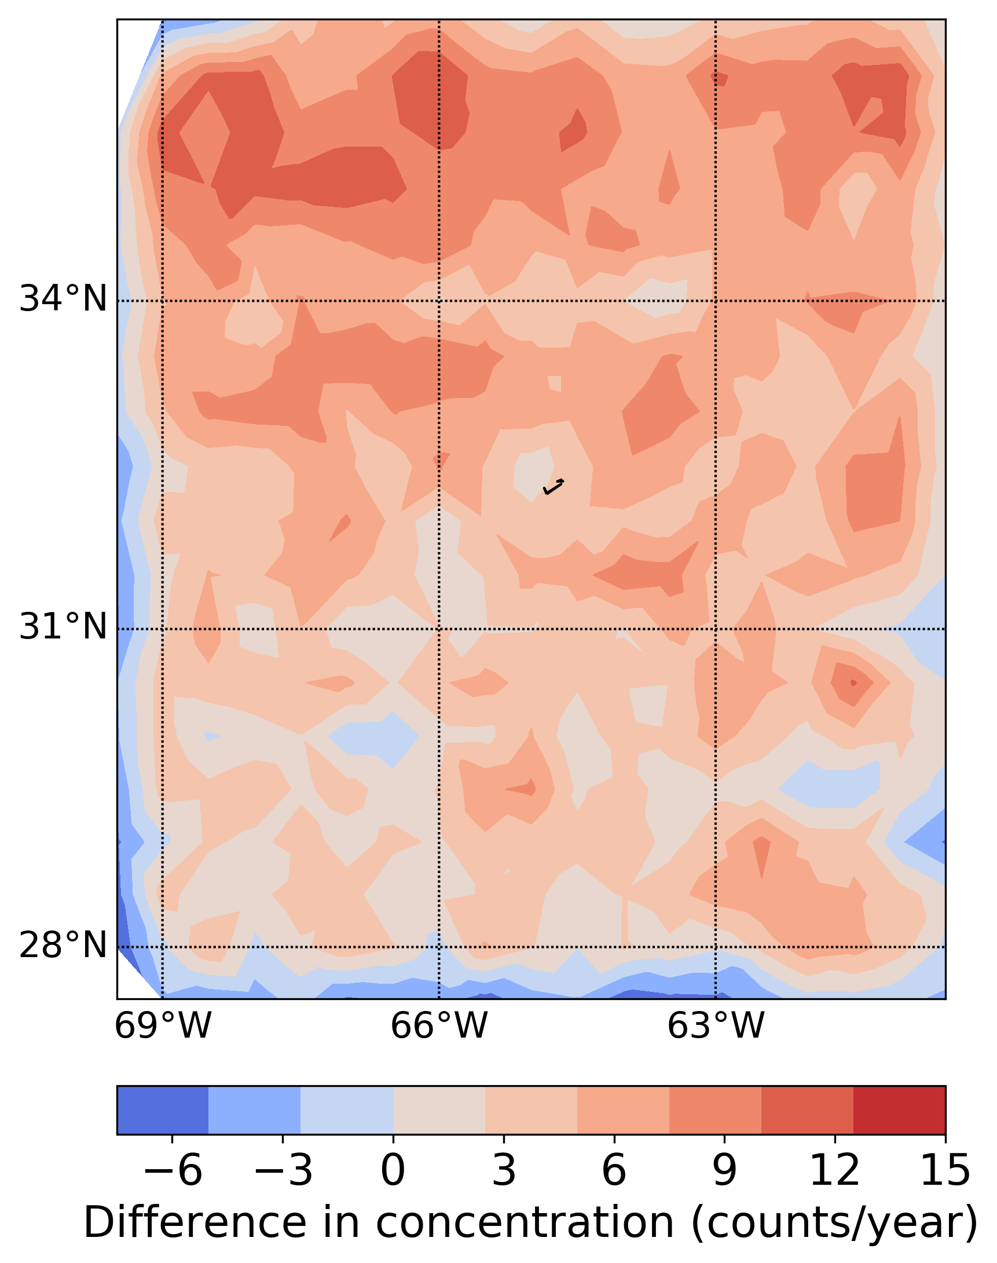
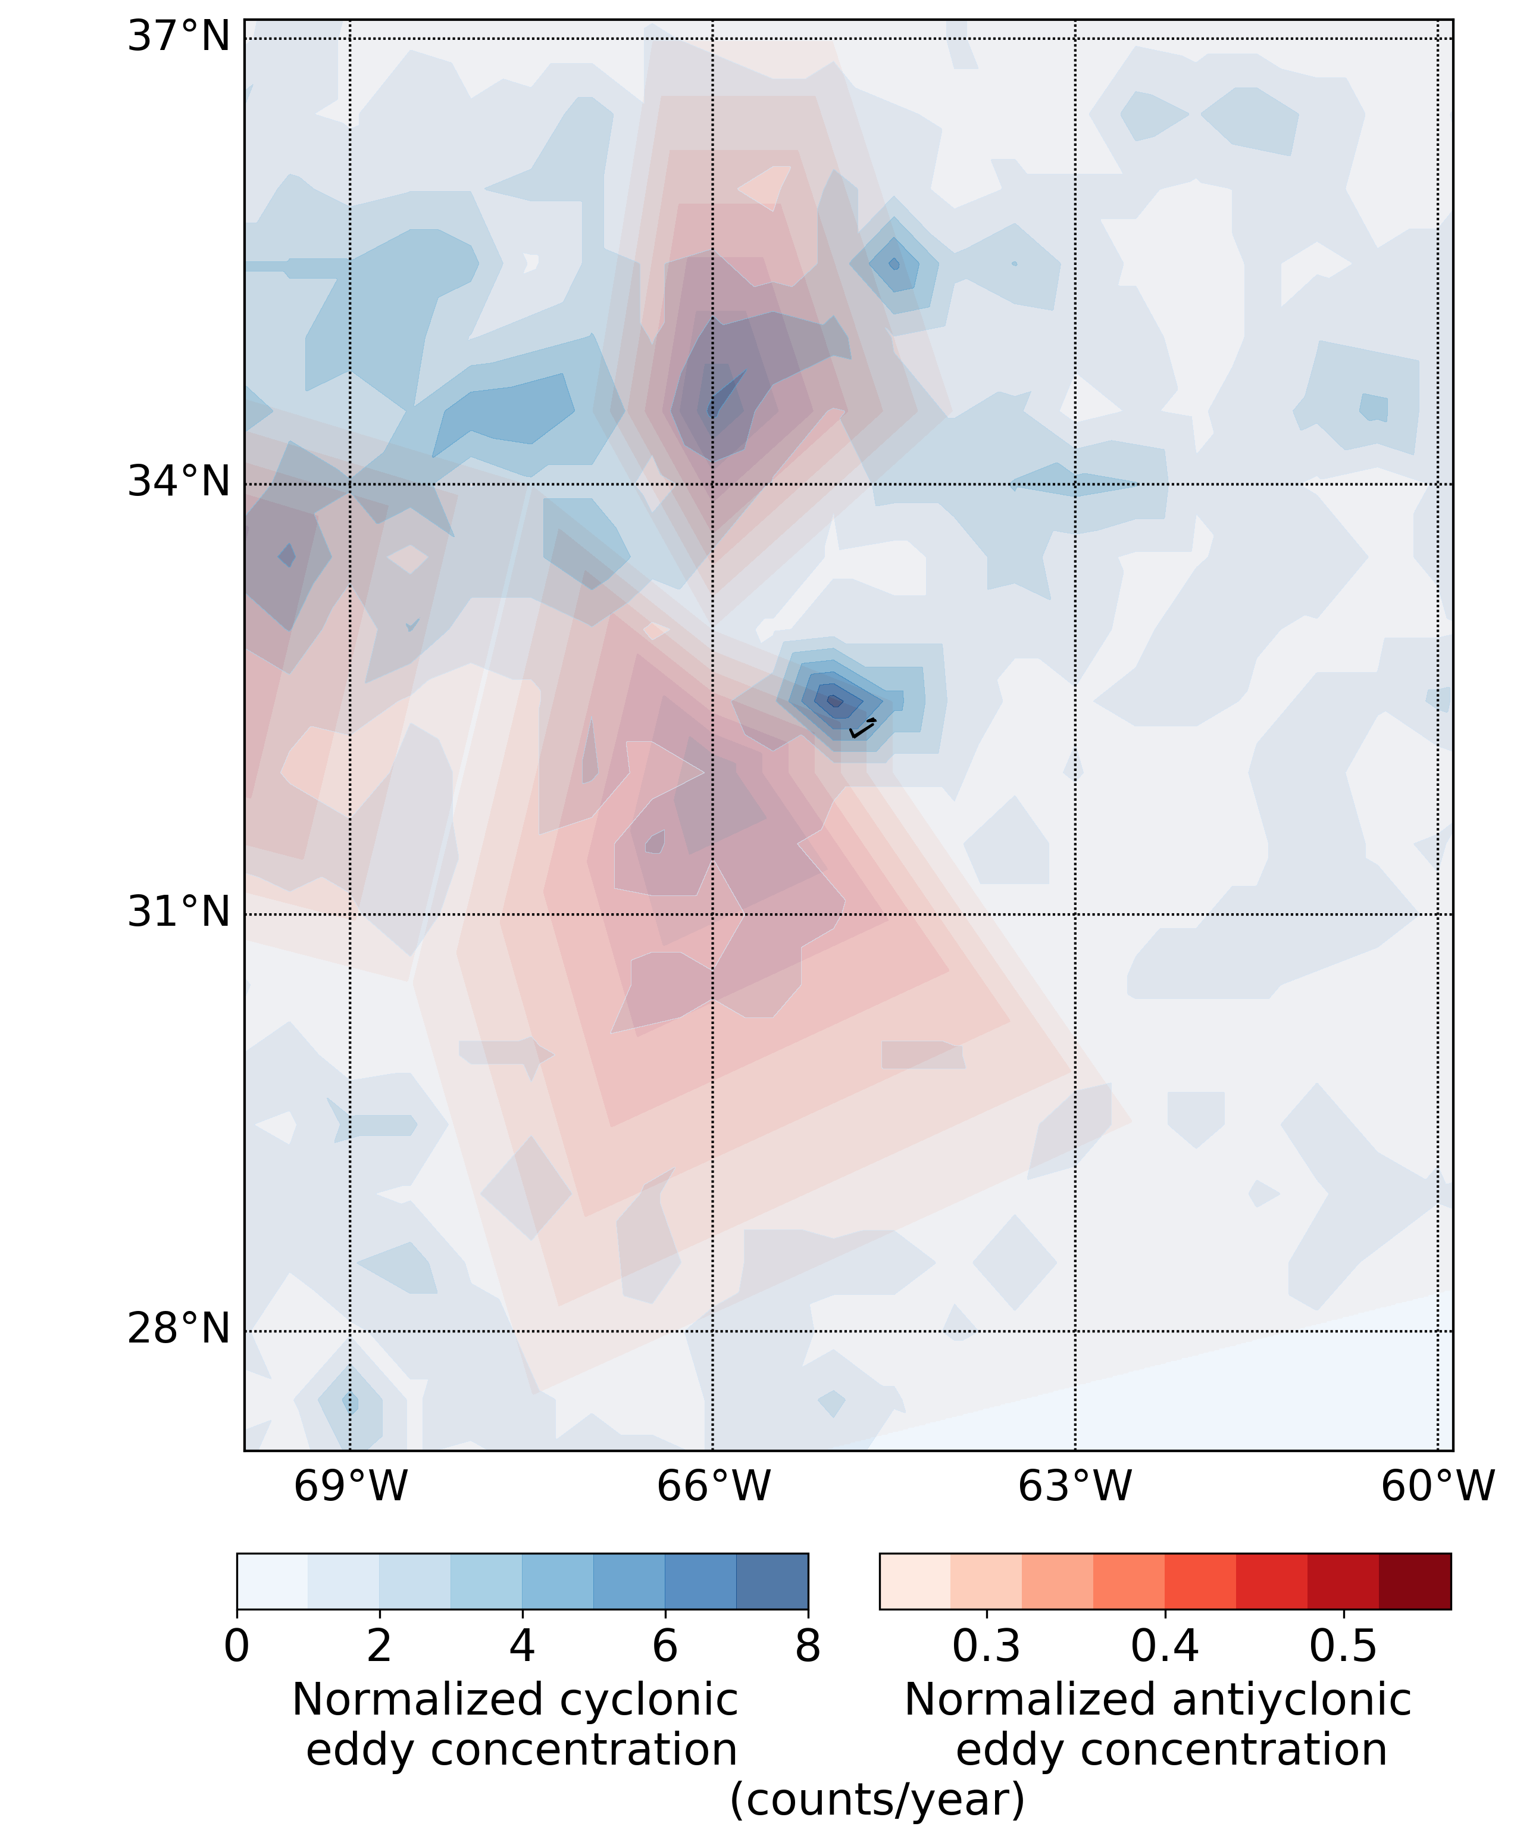
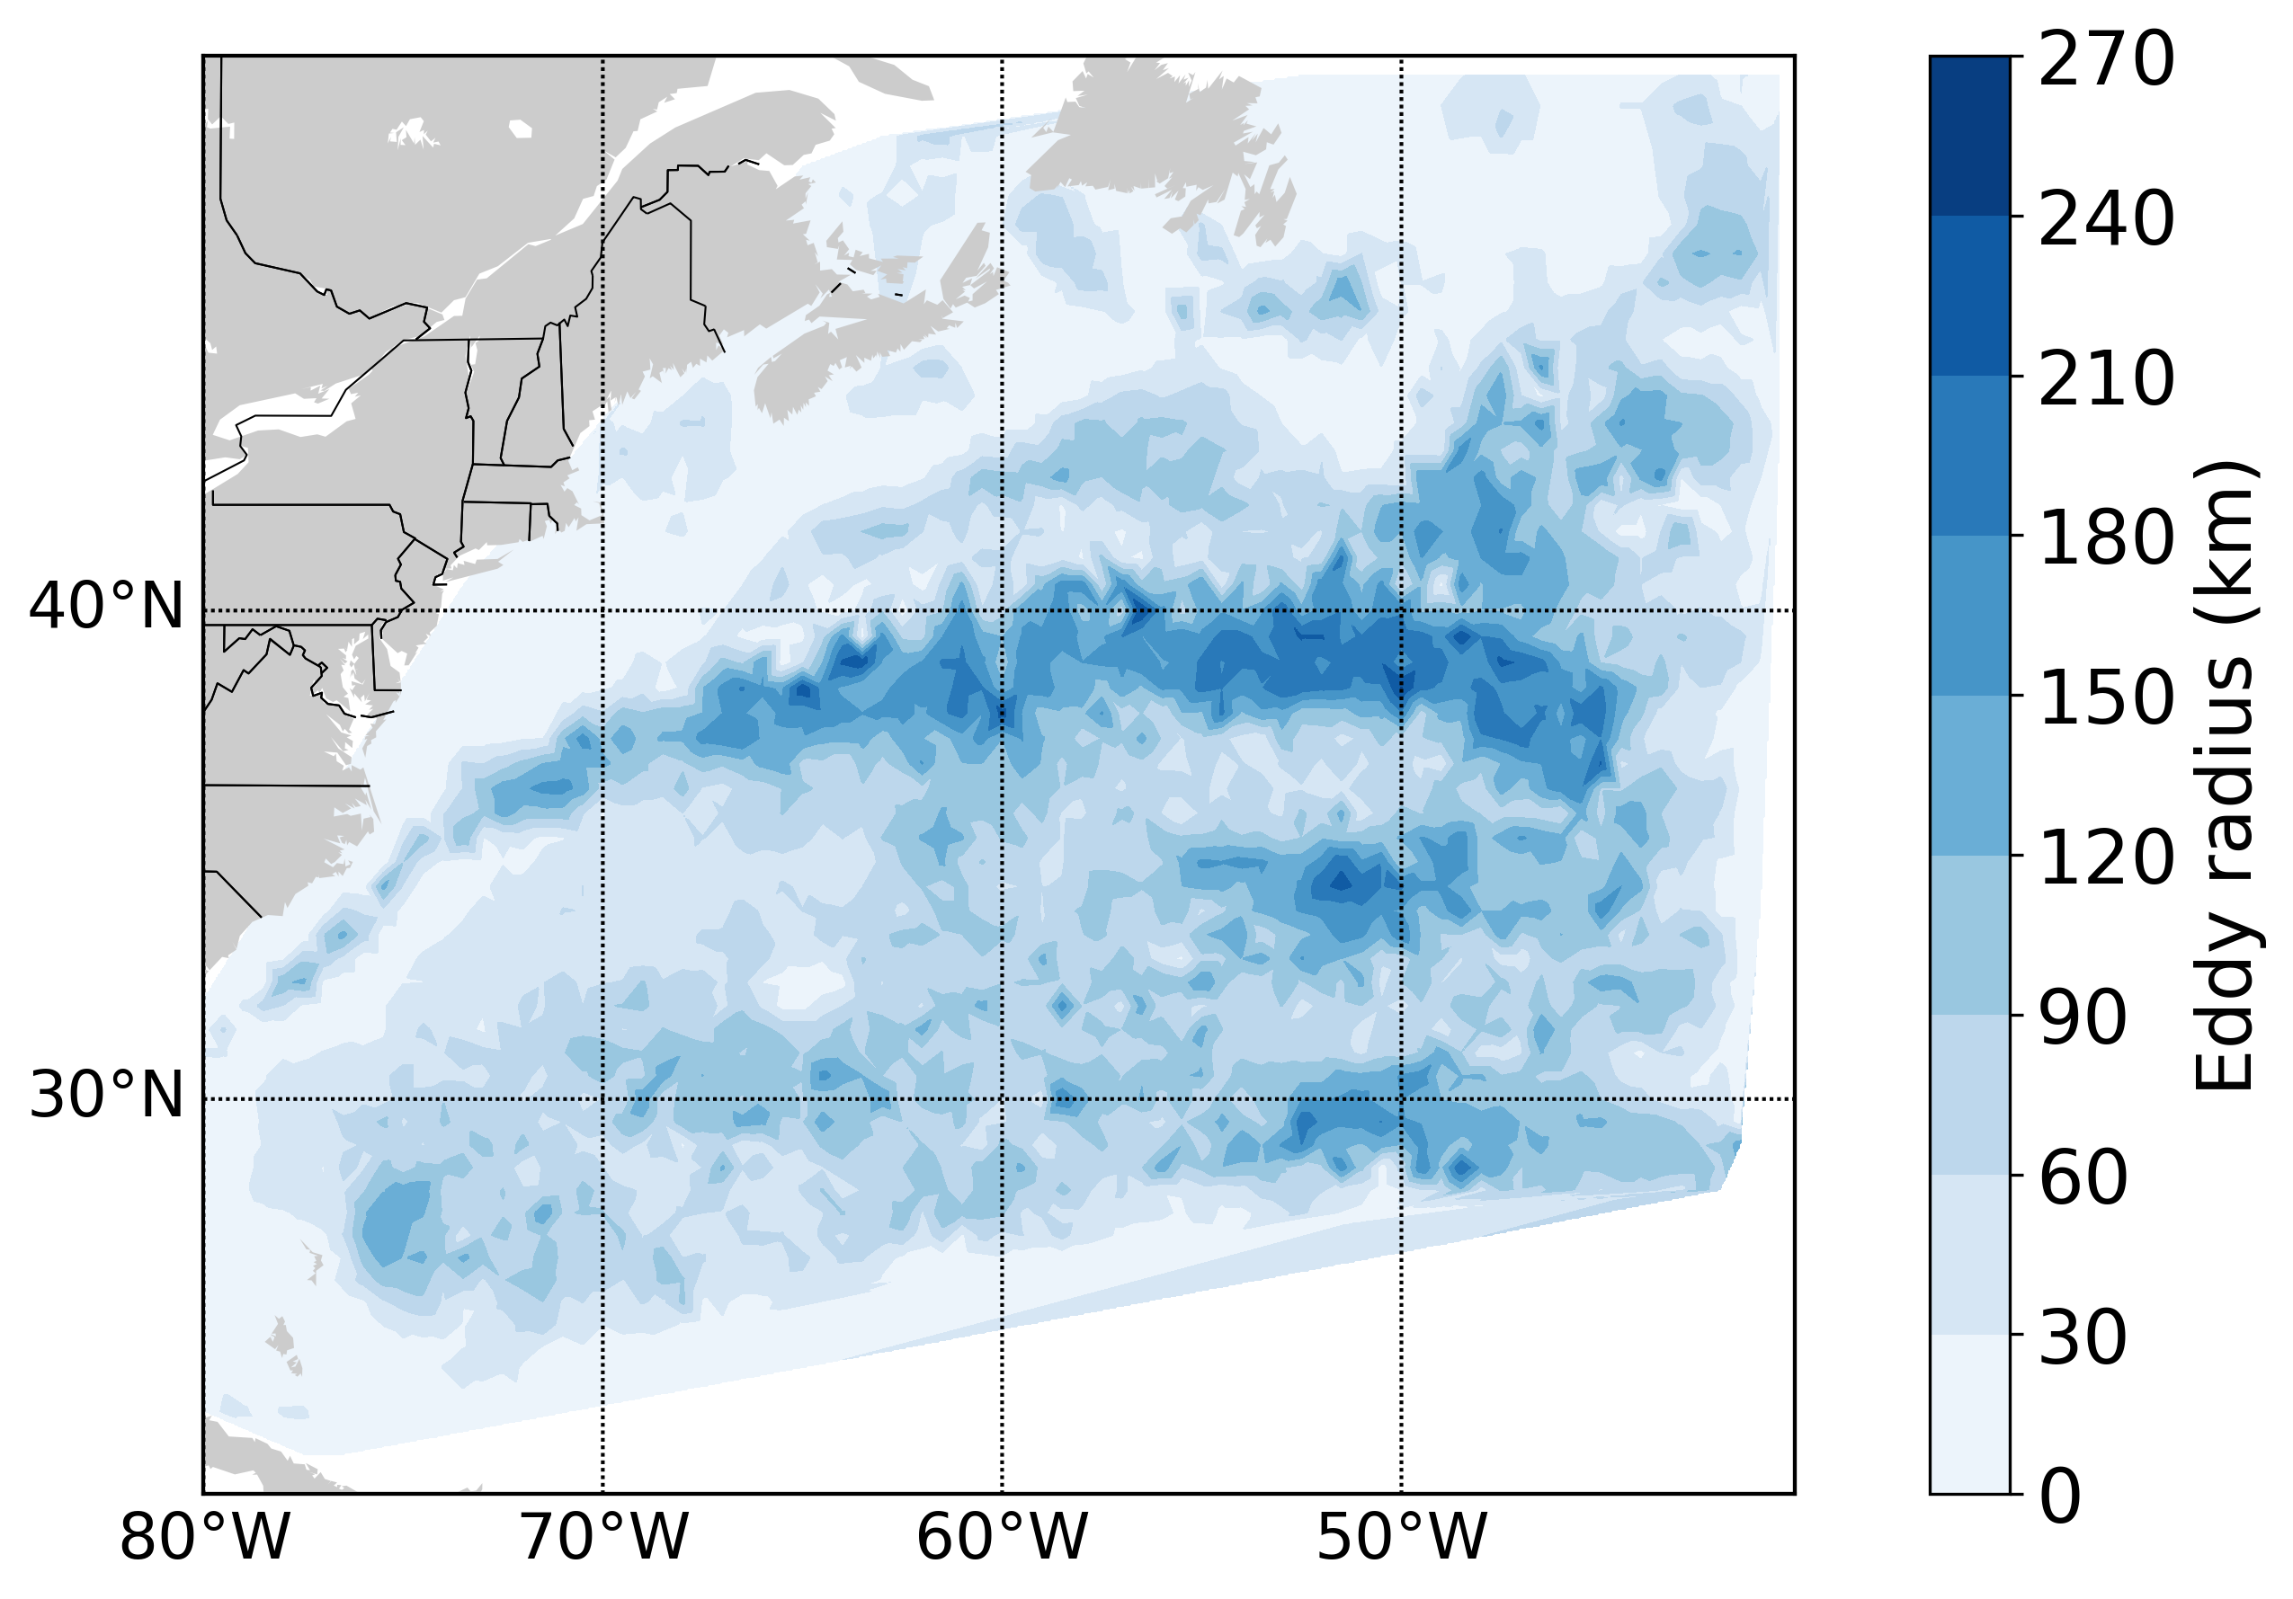
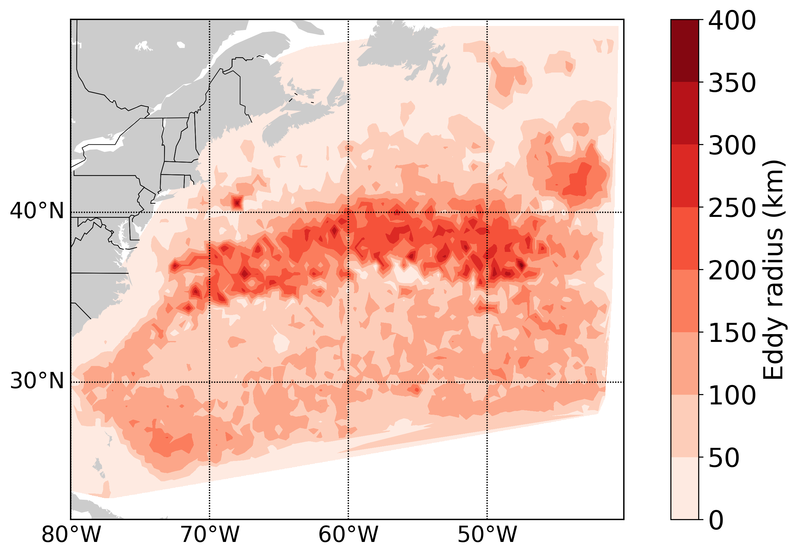
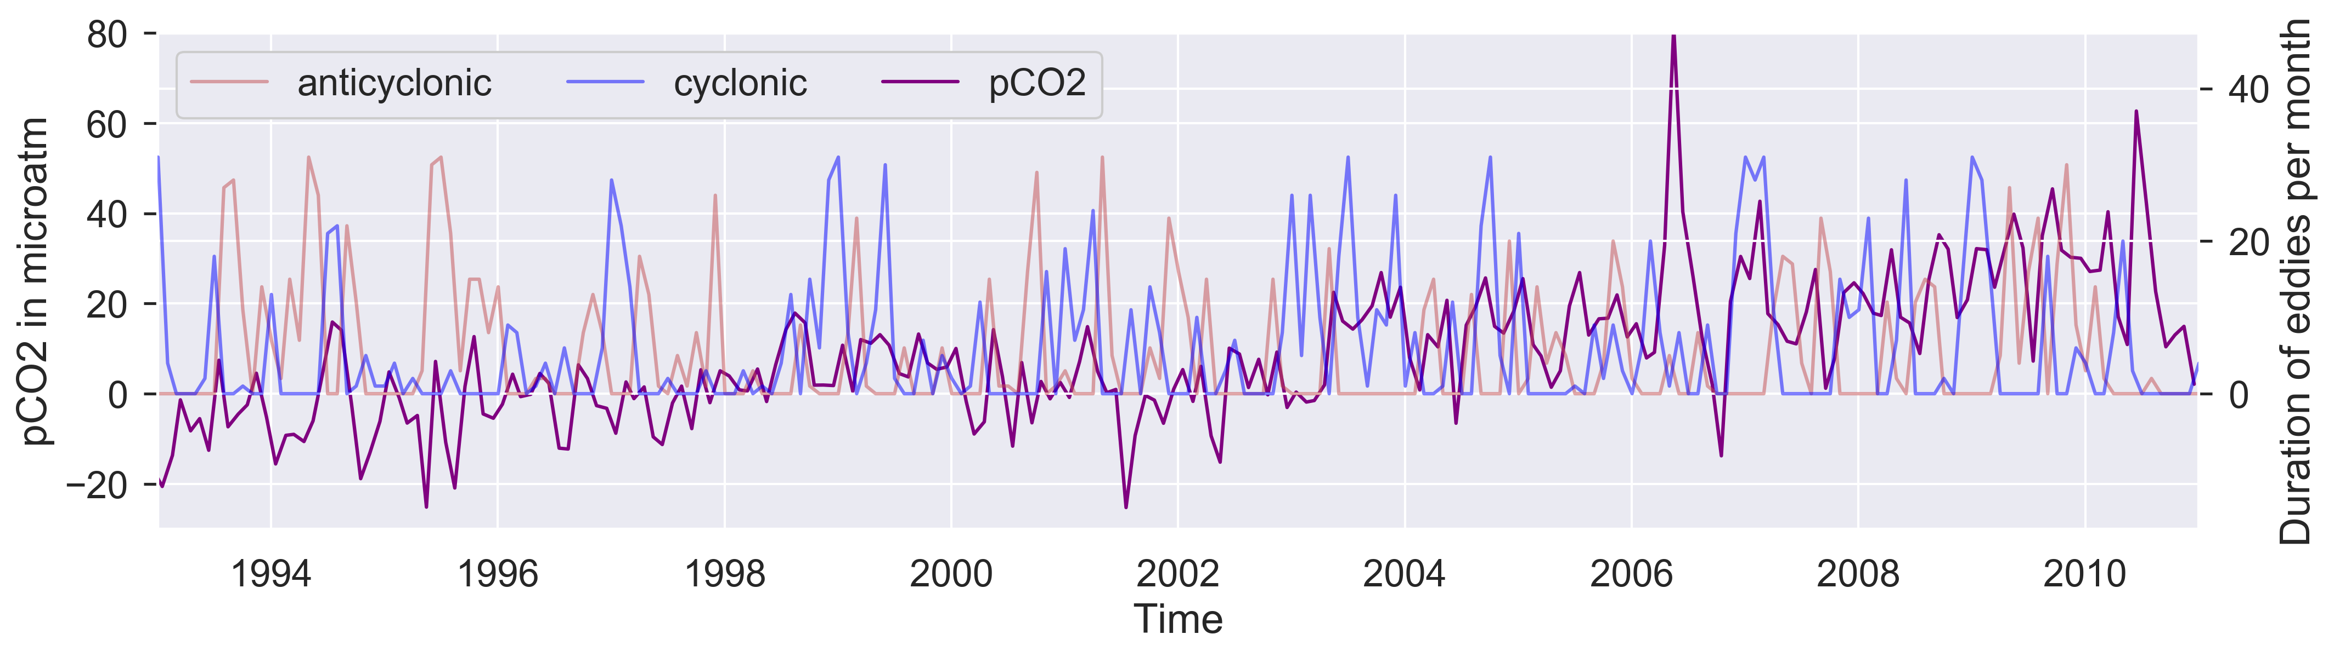
Mesoscale and submesoscale eddy dynamics in the Northwestern Atlantic
Kathleen Abbott1 | David Lindo-Atichati1,2,3 | James McWilliams4 | Jonathan Gula5
1 Department of Earth and Planetary Science, American Museum of Natural History, New York, NY, USA
2 Program in Earth and Environmental Sciences, Graduate Center of the City University of New York, New York, NY, USA
3 Department of Engineering and Environmental Science, College of Staten Island, City University of New York, Staten Island, NY, USA
4 Department of Atmospheric and Oceanic Sciences, University of California, Los Angeles, Los Angeles, CA, USA
5 Université de Brest, CNRS, IRD, Ifremer, Laboratoire d’Océanographie Physique et Spatiale, IUEM, Brest, France
Mesoscale eddies significantly affect ocean biogeochemistry[1], but the relative contribution of submesoscale eddies to the dynamics of the carbon system is not well understood. More than fifteen years of mesoscale and submesoscale eddy behavior in the northwestern Atlantic Ocean is analyzed from a high-resolution simulation of sea-level anomaly. Eddies, eddy properties and their corresponding tracks in the northwestern Atlantic region were identified and analyzed to understand spatial and temporal trends of eddy dynamics, particularly in the Sargasso Sea. We are currently using eddy statistics and in situ measurements of pH and CO₂ to study the correlation between eddy properties and CO₂ fluxes near Bermuda.
Tracking eddies in the Northwest Atlantic
Zooming in on Bermuda
(a)
(b)
(c)
Background and methodology
(d)
(e)
(f)
Fig 2. Trajectories of anticyclonic (red) and cyclonic (blue) eddies in the Northwestern Atlantic Ocean from an 18-year model run.
Fig. 5. (a) shows the concentration of cyclonic eddies from the ROMS model in a 10º by 10º grid around Bermuda. (b) shows the concentration of cyclonic eddies from satellite data analysis, and (c) shows the normalized difference between the two. (d) - (f) show the same visualizations for anticyclonic eddies. Because the model output is in 5-day intervals while satellite data is collected daily, model concentrations were scaled by 5.
(a)
We applied the same tracking algorithm to satellite altimetry in the Bermuda region and compared the two tracking outputs to assess the model’s accuracy. The two differed in some locations — in the model, a high density of cyclonic eddies are identified north of Bermuda — but generally agree within 5 eddies per year.
Fig 1. Map of study area, overlaid with sea level anomaly from observation 10 of the NWAT ROMS model. The rectangular box represents the area where satellite data was also analyzed for comparison.
Relationship to carbon transport
The Northwestern Atlantic Ocean (NWAT) is a dynamic region intersected by the Gulf Stream. Here, we used the following general circulation model and an eddy detection tool:
Modeled data of sea level anomaly in the NWAT region was generated from the Regional Ocean Modeling System with resolution of 2.5 km[2]
Eddies identified using py-eddy-tracker, an automated tracking algorithm based on sea surface height[3]
(b)
Comparing eddy statistics to 25 years of carbon data from Bermuda Atlantic Time-Series (BATS) to identify correlation between mesoscale processes and carbon transport on a range of time and length scales
Fig 4. Distribution of submesoscale eddies (diameter < 10 km) in the Bermuda analysis region. Concentrations were scaled by 5 because model output is in 5-day intervals.
Fig 3. (a) cyclonic and (b) anticyclonic eddy radius distributions.
Fig. 6. Timeseries of pCO2 data collected at the BATS site and eddy presence at the site from satellite data. The pCO2 data was corrected for seasonal variation.
References
[1] McGillicuddy Jr, D. J. (2016). Mechanisms of physical-biological-biogeochemical interaction at the oceanic mesoscale. Annu. Rev. Mar. Sci., 8, 125-159.
[2] Gula, J., Molemaker, M. J., & McWilliams, J. C. (2015). Gulf Stream dynamics along the southeastern US seaboard. J. Phys. Oceanogr., 45(3), 690-715.
[3] Mason, E., Pascual, A., & McWilliams, J. C. (2014). A new sea surface height–based code for oceanic mesoscale eddy tracking. J. Atmospheric and Oceanic Technol., 31(5), 1181-1188.
Contact Information:
Acknowledgements:
kabbott@amnh.org
This study has been conducted using E.U. Copernicus Marine Service Information. Code for contour maps and tracks were adapted from Chad Valencia. This work was supported by the National Ocean and Atmospheric Administration (NOAA) Fisheries And The Environment (FATE) award NA15OAR4170218. This work used the Extreme Science and Engineering Discovery Environment (XSEDE), which is supported by the National Science Foundation grant number NSF-OCE170005. Data supporting the analysis and conclusions are publicly available at https://github.com/dlindo/PYTHON

